Slide 1
Asynchronous JavaScript and XML
Ajax

Slide 2
HTTP Status Code
1×× Informational
100 Continue
101 Switching Protocols
102 Processing
2×× Success
200 OK
201 Created
202 Accepted
203 Non-authoritative Information
204 No Content
205 Reset Content
206 Partial Content
207 Multi-Status
208 Already Reported
226 IM Used
4×× Client Error
400 Bad Request
401 Unauthorized
402 Payment Required
403 Forbidden
404 page not found
405 Method Not Allowed
406 Not Acceptable
407 Proxy Authentication Required
408 Request Timeout
409 Conflict
410 Gone
411 Length Required
412 Precondition Failed
413 Payload Too Large
414 Request-URI Too Long
415 Unsupported Media Type

Slide 3
HTTP Status Code
416 Requested Range Not Satisfiable
417 Expectation Failed
418 I'm a teapot
421 Misdirected Request
422 Unprocessable Entity
423 Locked
424 Failed Dependency
426 Upgrade Required
428 Precondition Required
429 Too Many Requests
431 Request Header Fields Too Large
444 Connection Closed Without Response
451 Unavailable For Legal Reasons
499 Client Closed Request
5×× Server Error
500 Internal Server Error
501 Not Implemented
502 Bad Gateway
503 Service Unavailable
504 Gateway Timeout
505 HTTP Version Not Supported
506 Variant Also Negotiates
507 Insufficient Storage
508 Loop Detected
510 Not Extended
511 Network Authentication Required
599 Network Connect Timeout Error

Slide 4
AJAX(Asynchronous JavaScript and XML)
AJAX is is a group of inter-related technologies like JavaScript, DOM, XML, HTML/XHTML, CSS, XMLHttpRequest etc.
AJAX helps you to create smarter web applications that send and receive the important data to the server without reloading the entire page.
AJAX allows you to send and receive data asynchronously without reloading the web page. So it is fast.
AJAX allows you to send only important information to the server not the entire page.
So only valuable data from the client side is routed to the server side. It makes your application interactive and faster.

Slide 5
AJAX in NUTSHELL
Update a web page without reloading the page
Request data from a server - after the page has loaded
Receive data from a server - after the page has loaded
Send data to a server - in the background

Slide 6
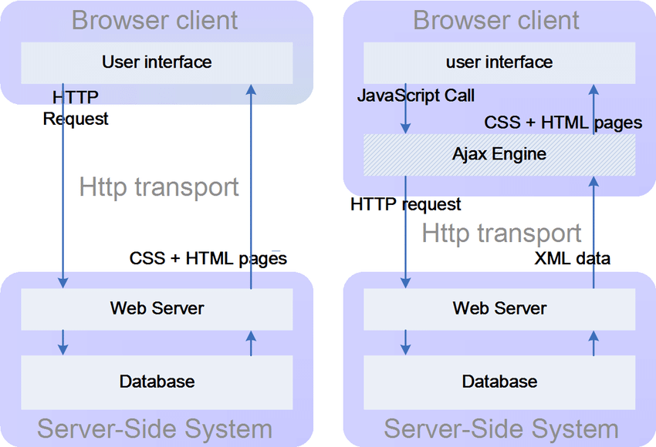

Without & With AJAX

Slide 7
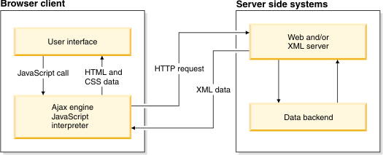

Slide 8
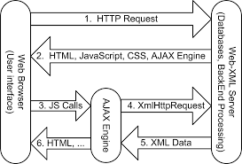

Slide 9
What is AJAX?
AJAX = Asynchronous JavaScript And XML.
AJAX is not a programming language.
AJAX just uses a combination of:
A browser built-in XMLHttpRequest object (to request data from a web server)
JavaScript and HTML DOM (to display or use the data)
Note: AJAX applications might use XML to transport data, but it is equally common to transport data as plain text or JSON(JavaScript Object Notation) text.

Slide 10
Examples of Applications using AJAX
There are too many web applications running on the web that are using ajax technology like gmail, facebook,twitter, google map, youtube etc.

Slide 11
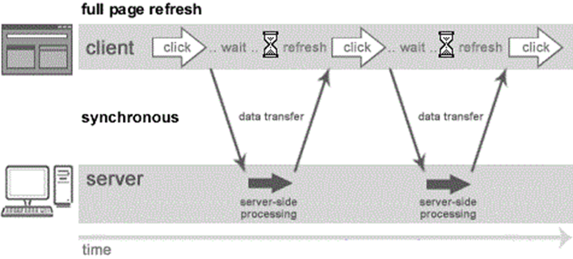
Understanding Synchronous vs Asynchronous
Synchronous (Classic Web-Application Model)
A synchronous request blocks the client until operation completes i.e. browser is unresponsive. In such case, javascript engine of the browser is blocked.
As you can see in the above image, full page is refreshed at request time and user is blocked until request completes.

Slide 12
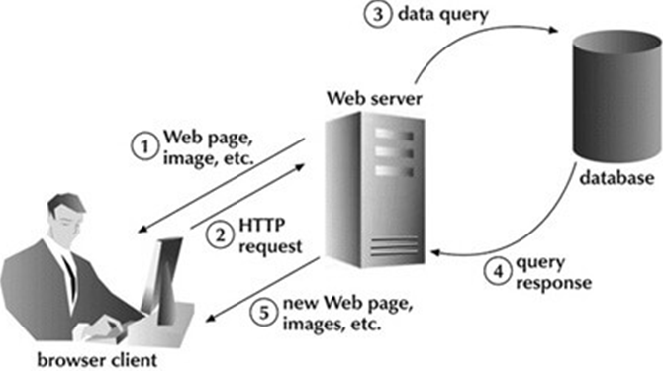
Synchronous Flow

Slide 13
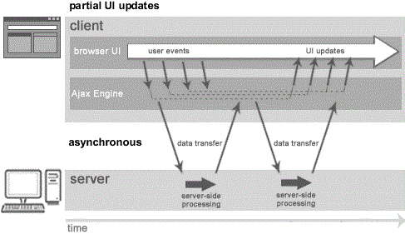
Asynchronous (AJAX Web-Application Model)
An asynchronous request doesn’t block the client i.e. browser is responsive. At that time, user can perform another operations also. In such case, javascript engine of the browser is not blocked.
As you can see in the above image, full page is not refreshed at request time and user gets response from the ajax engine.

Slide 14
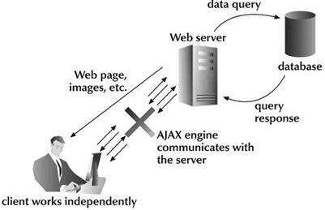
Asynchronous communication
Note: every blocking operation is not synchronous and every unblocking operation is not asynchronous.

Slide 15
Technologies used in AJAX
The technologies that AJAX uses are already present in all modern web browsers, which means the client does have to install any extra library to run an AJAX website. AJAX consists of the following components-
JavaScript- It is an essential part of AJAX that enables you to provide the client side functionality. JavaScript has functions that enable you to manipulate the HTML page.
XMLHttpRequest- Object of XMLHttpRequest allows you to send request to the server asynchronously or synchronously in the background.
Server-Side Technology- Programming languages such as PHP, JSP, ASP.NET, etc. is required to handle the request that comes from the JavaScript client.

Slide 16
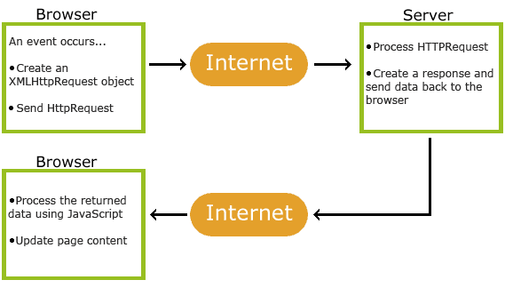

Slide 17
Advantage & Disadvantage
Advantages of AJAX
  Cross-browser & cross-platform compatibility
  Better & richer user experience
  Web programming flexibility
  Reduced consumption of server resources
Disadvantages of AJAX
  Source code of AJAX is viewable.
  It depends on javascript and cannot work if javascript is disabled in a web browser.
  You cannot bookmark the content generated by AJAX.

Slide 18
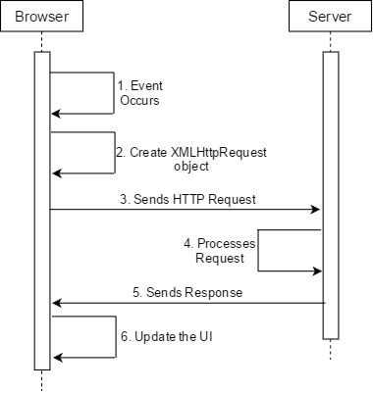
Working of AJAX
Using XMLHttpRequest object, we can communicate with the server. Following are the steps how AJAX works-
The user generates event such as button click, selection of dropdown.
Brower handles the event via a JavaScript and creates an object of XMLHttpRequest.
Brower sends the request to the server for processing.
The server processes the request by interaction with the databases using any one of the server-side programming languages like PHP, JSP, ASP.NET, etc.
The server sends the response to the browser. And the browser receives the response in XMLHttpRequest callback function in the form of JSON or XML data.
The browser updates the UI by making changes in HTML and CSS of a webpage without reloading the entire webpage.

Slide 19
XMLHttpRequest
XMLHttpRequest helps browser in transferring data between a browser and server.
Without refreshing a full page, it provides a simple technique to fetch data from a server.
The best part of XMLHttpRequest is that updates a part of the web page without interrupting what the user is performing.

Slide 20
How to use XMLHttpRequest
Following are the steps that you must follow to build AJAX applications using XMLHttpRequest-
Create an object of XMLHttpRequest by calling its constructor.
Assign a function to an event handler onreadystatechange. In the function check the value of readyState and status to obtain the response from the server.
Call open() method to initialize a method. In this method, specify three parameters- the type of HTTP method, URL to whom the request is to be sent, and true to call asynchronously.
Call send() method to send the request to the server.

Slide 21
Example
AJAX stands for "Asynchronous JavaScript and XML."
var request = new XMLHttpRequest();
request.onreadystatechange = function(){
if(this.readyState == 4 && this.status == 200)
{
var response = this.responseText;
alert(response);
}
};
request.open("GET", "url", true);
request.send();

Slide 22
AJAX - Server Response
The onreadystatechange Property
The readyState property holds the status of the XMLHttpRequest.
The onreadystatechange property defines a function to be executed when the readyState changes.
The status property and the statusText property holds the status of the XMLHttpRequest object.

Slide 23
The onreadystatechange Property
Property | Description
onreadystatechange | Defines a function to be called when the readyState property changes
readyState | Holds the status of the XMLHttpRequest. 0: request not initialized 1: server connection established 2: request received 3: processing request 4: request finished and response is ready
status | 200: "OK" 403: "Forbidden“ //Deny 404: "Page not found" For a complete list go to the Http Messages Reference
statusText | Returns the status-text (e.g. "OK" or "Not Found")

Slide 24
Ready state
The onreadystatechange function is called every time the readyState changes.
When readyState is 4 and status is 200, the response is ready:

Slide 25
function loadDoc() {
var xhttp = new XMLHttpRequest(); //object created
xhttp.onreadystatechange = function() {
if (this.readyState == 4 && this.status == 200) {
document.getElementById("demo").innerHTML =
this.responseText;
}
};
xhttp.open("GET", "ajax_info.txt", true);
xhttp.send();
}

Slide 26
Functions of XMLHttpRequest
Functions | Explanation
abort() | This function is used to cancel the current request.
getAllResponseHeaders() | It returns all the response headers in the form of a string.
getResponseHeader() | This function returns the value of the specified header.
open(method,url,async,uname,pswd) | This method is used to initialized the request. It takes the following arguments - method- the type of HTTP method such as GET, POST, etc. url- Specifies the file on the server to send the request to. async- It is optional, and by default it is true. A false value indicates that the request must be handled synchronously and true value indicates asynchronously. username & password- Optional and by default it is null. Use for authentication purposes.
send(string) | It sends the request to the server. If the HTTP method of a request is POST, then the argument of this function is not ignored.
setRequestHeader(header, value) | This methods must be called before send() method and after open() method. It is used to set the header of HTTP request.

Slide 27
<!DOCTYPE html><html> <head>
<script>
function fetch(){
var request = new XMLHttpRequest();
request.onreadystatechange = function(){
if(this.readyState == 4 && this.status == 200){
var response = this.responseText;
document.getElementById("mobiles").innerHTML=response;
}
};
request.open("GET", “start.jsp", true);
request.send();
}
</script> </head>
<body>
<button onclick="fetch()">Show Details</button>
<div id="mobiles"></div>
</body></html>

Slide 28
Start.jsp
<%
out.print("Name: Samsung Galaxy J7<br />");
out.print("Price: 15500<br />");
out.print("Screen Size: 5.5<br />");
out.print("Operating System: Android 6.0<br />");
%>

